Slide 1
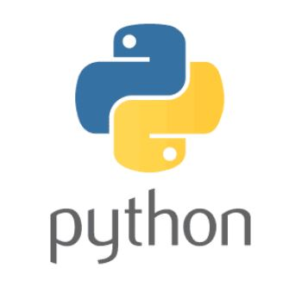
RESERVED WORDS

Slide 2
In Python some words are reserved to represent some meaning or functionality. Such types of words are called reserved words.
There are 33 reserved words available in Python.
True, False, None,
and, or ,not,is,
if, elif, else,
while, for, break, continue, return, in, yield,
try, except, finally, raise, assert,
import, from, as, class, def, pass, global, nonlocal, lambda, del, with

Slide 3
Note:
1. All Reserved words in Python contain only alphabet symbols.
2. Except the following 3 reserved words, all contain only lower-case alphabet symbols.
True
False
None
Eg:→ a= true 
a=True √
Program:--
import keyword
>>> keyword.kwlist
Output:--
['False', 'None', 'True', 'and', 'as', 'assert', 'break', 'class', 'continue', 'def', 'del', 'elif', 'else', 'except', 'finally', 'for', 'from', 'global', 'if', 'import', 'in', 'is', 'lambda', 'nonlocal', 'not', 'or', 'pass', 'raise', 'return', 'try', 'while', 'with', 'yield']

